Slide 1
Google Analytics:
Overview

Slide 2
Introduction and disclaimer
These slides provide a short summary overview of some of the key features of Google Analytics (GA)
They’re based on limited experience with the platform, primarily:
The Google Analytics for Beginners training course;
The Advanced Google Analytics training course;
Some personal experimentation.
Note: Google Analytics contains a lot of functionality that isn’t described here!
If you need a more complete understanding, start with the training courses above.
The slides are focussed on gaining a high-level understanding of the platform, from an analytics perspective (rather than a marketing perspective)
They also try to flag some of the issues to be aware of when using the platform

Slide 3
Wot I done
I found the training courses useful, but sometimes a little too “point and click”
Everything was already set up at the back-end, and couldn’t be changed
I find it easier to understand something if I’ve done it myself, outside the “canned” problem
So I had a go at setting up my own (very small, rubbish) example:
Created a GA account and generated a tracking cookie;
Created a website with Flask, and deployed it on Heroku (and then also on Azure);
Created a second website with Wix, that links to the Flask site (for referrals);
Added in some custom events to the Flask site (just clicks on website components);
Generated some traffic with Selenium.
For me, this was really useful and helped to understand how the system works in a bit more detail
Also more fun than just doing the training exercises, and exposed some issues

Slide 4
GA overview
What it is: Google Analytics is a free platform for tracking website usage.
Some examples of where it can be useful:
Helping UX experts to understand how users interact with a website:
Which pages have the most hits;
How long do people spend on the site, and on which pages;
Types of device they’re using; etc.
Helping marketing experts to:
Track results of advertising campaigns;
Understand user demographics (including age, gender, location, language);
See how users navigated to the site; etc.
[Note that all metrics are tracked over time]
Overall: the aim of the platform is to help the ‘owners’ of a website understand how it’s used, without needing to be technical experts (either in analytics, or in web dev)

Slide 5
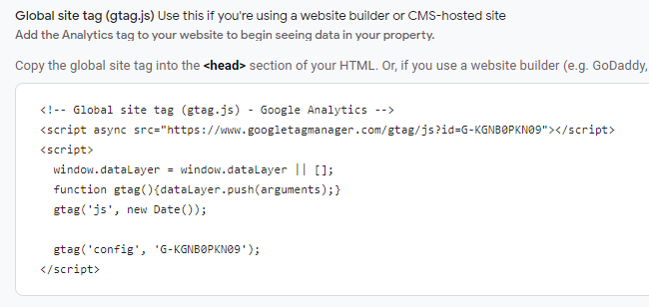
Google Analytics setup
Adding Google Analytics support is pretty straightforward:
Create an account. It’s easy and free; https://analytics.google.com/analytics/web/
Create a new Property (in Admin). This points to the website or app you want to track. Google Analytics will auto-create a JavaScript tag
Create and deploy your website. Write the HTML / use a CMS / whatever, and add the tag to <head>
That’s it! Now if you navigate to Google Analytics, you’ll see reports and data being generated as you browse around your website.

Slide 6
What gets captured?
Briefly; all sort of things. Some events captured by default (for web sites):
click, the number times a user clicks on a link away from the current domain (sort of…)
file_download, the number times a user tries to download a file (with specific extensions)
first_visit, the number of times a user visits the site for the first time (sort of…)
page_view, the number of visits to the site
scroll, the first time a user reaches the bottom of each page
session_start, when a user opens the website
[Full list here: https://support.google.com/analytics/answer/9234069?hl=en]
It’s also possible to set up custom events, like clicks of a particular button; completion of a sale; even dwell-time of a mouse (not tested!).
However, this needs to be done either through Google Tag Manager (separate tool) or by adding a tag via JavaScript (e.g. if collecting button-clicks, would set a tag in the <button>.onclick() event)
Can also log the source URL of traffic to your site. E.g. if another website (or search engine, or email, or…) contains a link to your site, you can set up GA to log where the page view originated from.
This is done via a tool call URL Builder: https://ga-dev-tools.web.app/campaign-url-builder/
Also a lot of user information, like the geo location the user browsed from; device info (e.g. type, browser, OS etc.); if available, their demographic information (they need to give permission, and it requires a specific box-check in setup);…

Slide 7


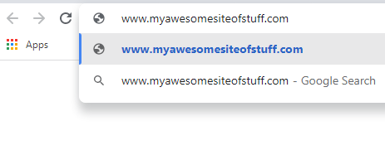

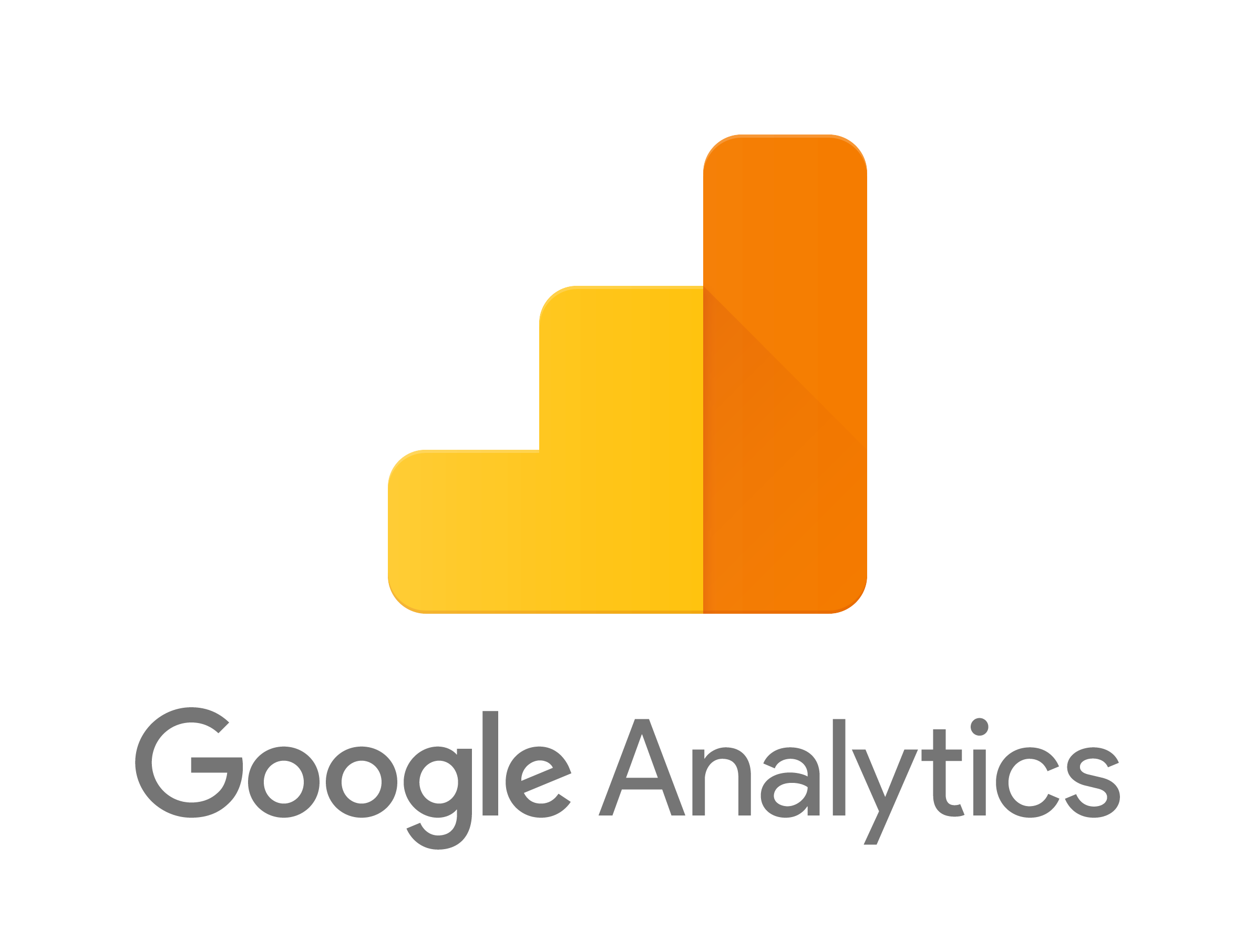

Example scenario
You have developed a website that sells stuff.
Your website is doing pretty well; people seem to like your stuff. You want to grow your sales, so you do the following:
Pay for some advertising on Google Ads
Set up an email campaign to existing customers about some new stuff they might like
Link to your site from other websites that you run
You now want to know how well these things have worked (esp compared to other ways of navigating to the site, like search engine results and direct browsing).
My other awesome site
My awesome site of stuff

Slide 8
How do you view all the information?
GA contains a pretty extensive reporting capability
Lots of native reporting within the tool, with lots of possible customisations
Reporting / visualisation is 90% of the Google Analytics UI
Reporting is broken down in the following ways:
Audience: all about the users. How many, over what time-period, how long they stayed for, where they are, what devices they’re using, whether they’ve visited before…
Acquisition: where users visited the site from. E.g. did they navigate directly to the site, did they link from somewhere else (and if so, where)…
Behaviour: what users did when they got to the site. Which pages did they visit, how long did they spend on each, bounce rate (% of times a user browses away straight from the landing page), user journeys…
Conversions: whether users did specific things that you wanted them to do. Include Goals (metrics you set to understand whether the site is achieving its objectives), Ecommerce (purchasing-type activity), and different paths that lead to these results.
Can also export data from reports, either as files or to another platform
Export to Google tools like BigQuery seems straightforward; can also connect to BI tools, like Tableau

Slide 9
Some Points to Note
Versions: in Oct 2020, Google released Google Analytics 4 (GA4), replacing the previous version, Universal Analytics (UA). However, UA is still widely used. There are some big differences, so it’s really important to know which version you’re working with.
Global tags: a global tracking tag is intended to be unique to a particular website. However, if a tag generated for website A is embedded into website B, GA will treat all behaviour from website B as though it were generated in website A
App tracking: although websites can track quite a bit by default, apps can track a lot more. See https://support.google.com/analytics/answer/9234069?hl=en for details.
Site cookies: GA needs third-party cookies and JavaScript to be enabled on a browser, or it won’t work (AFAIK). Also, clearing cookies between sessions will cause some metrics to be collected incorrectly (e.g. returning users).

